Slide 1
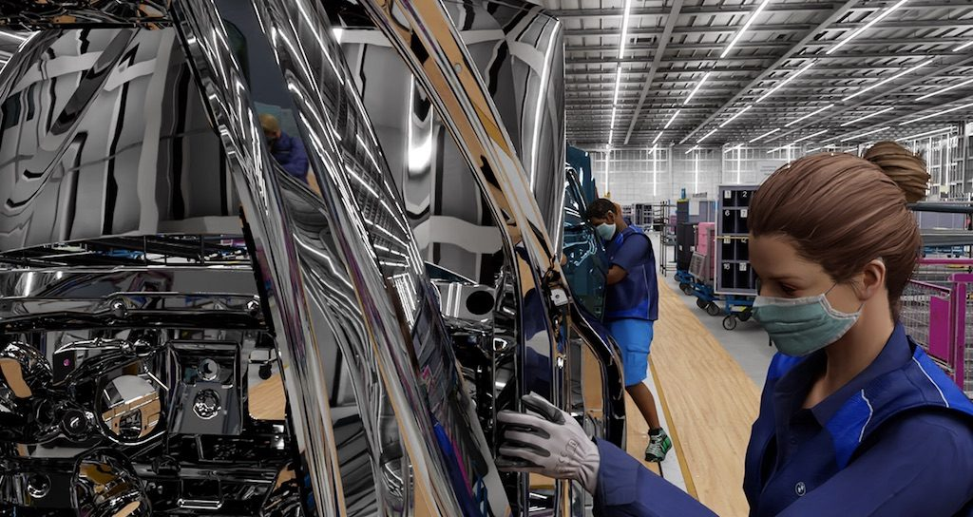
Synthetic Data Generation
for Machine Learning
Savelyev A.S. M107-22

Slide 2



Abstract
Oh no...
We have no enough data...
Just generate it,
Bruh...

Slide 3
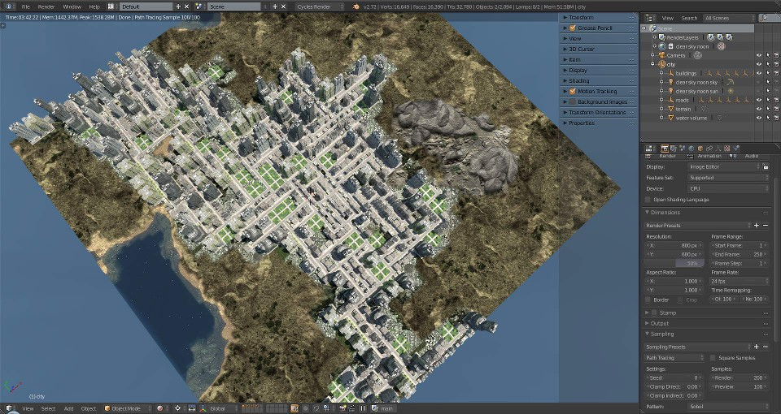
What is synthetic data
3D-Scene created
using City Generator

Slide 4
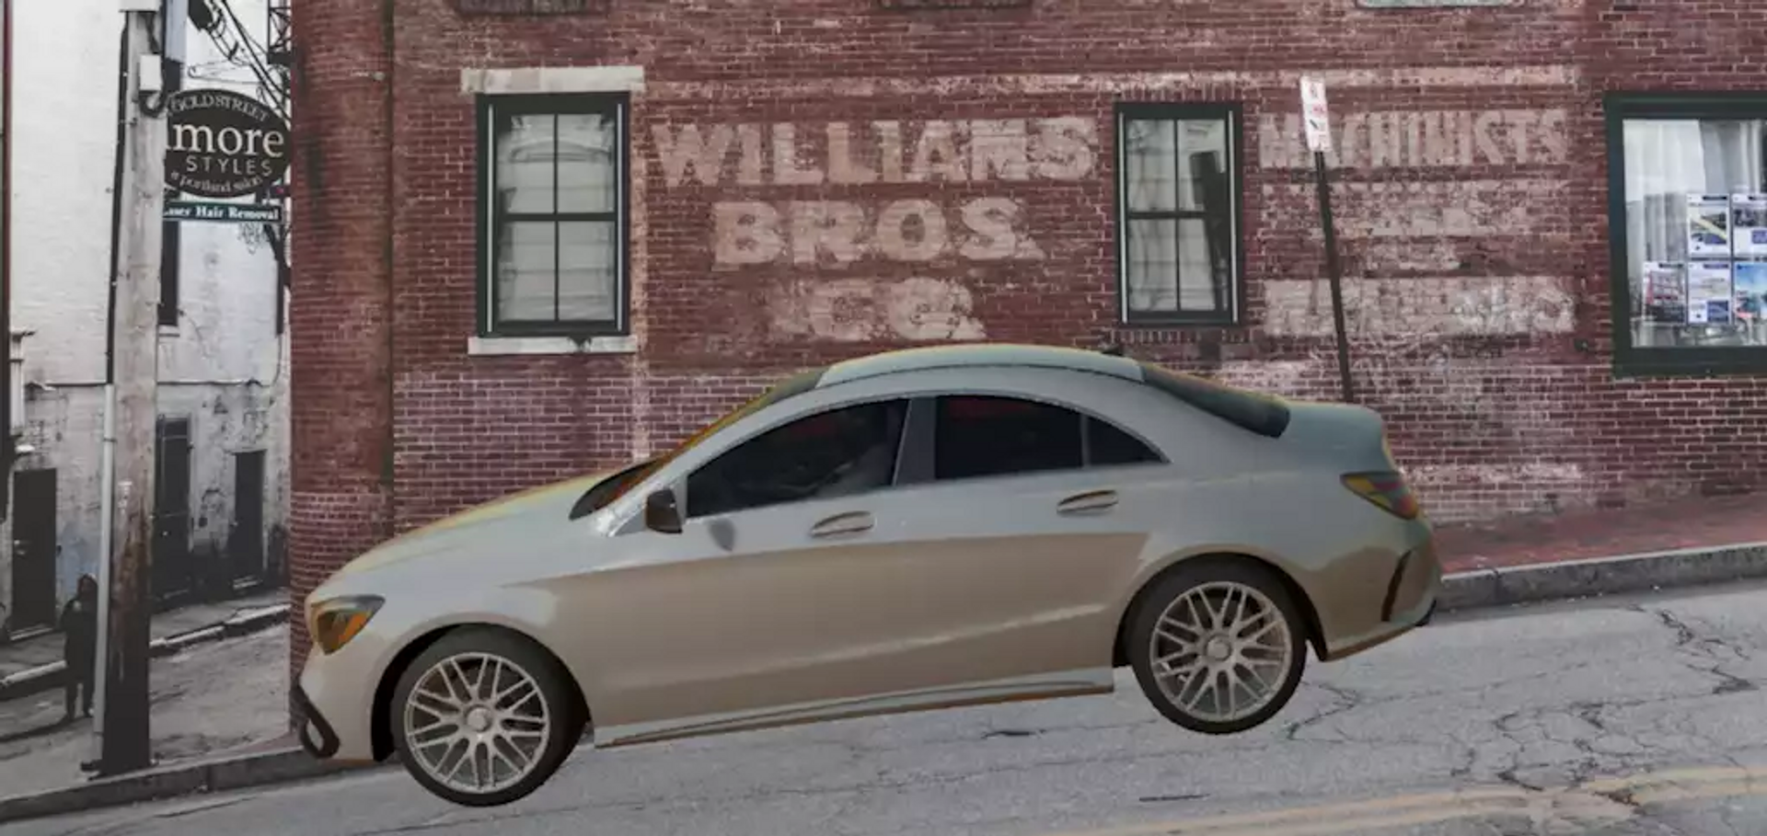
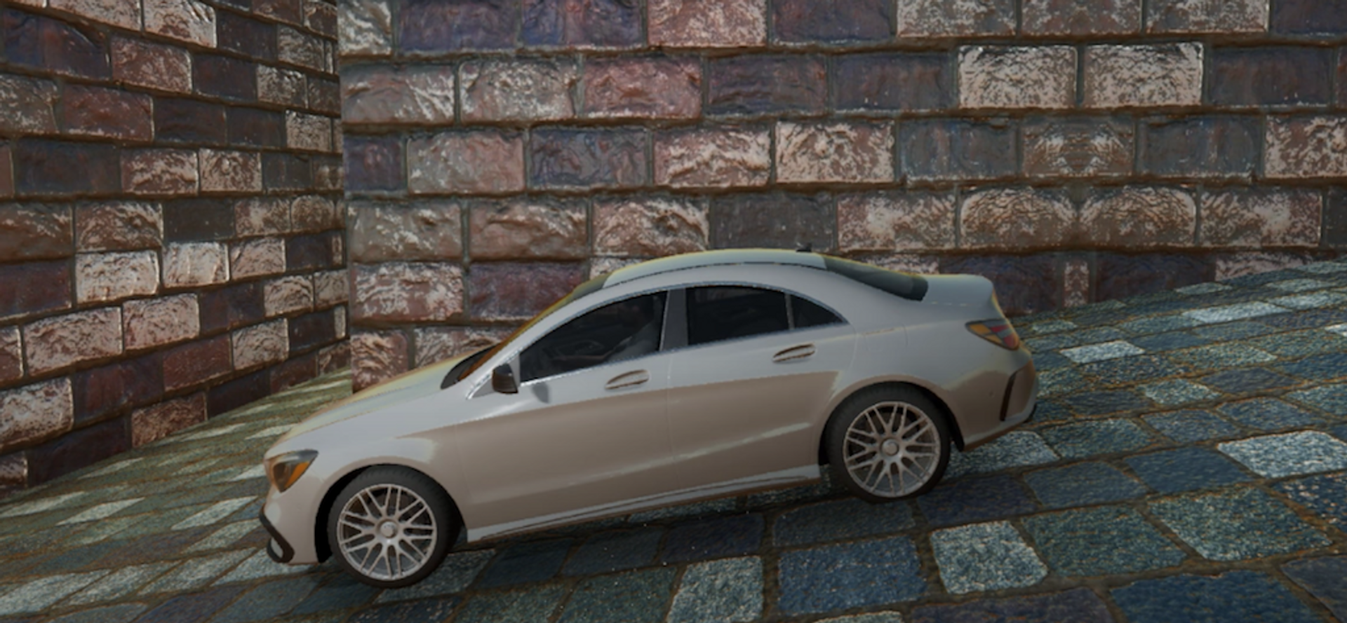
Types of
synthetic data
- Partial Type
Background is real,
car is not
- Full type
Background and car
is not real

Slide 5
Types of
synthetic data
- Partial Type
Background is real,
car is not
- Full type
Background and car
is not real

Slide 6
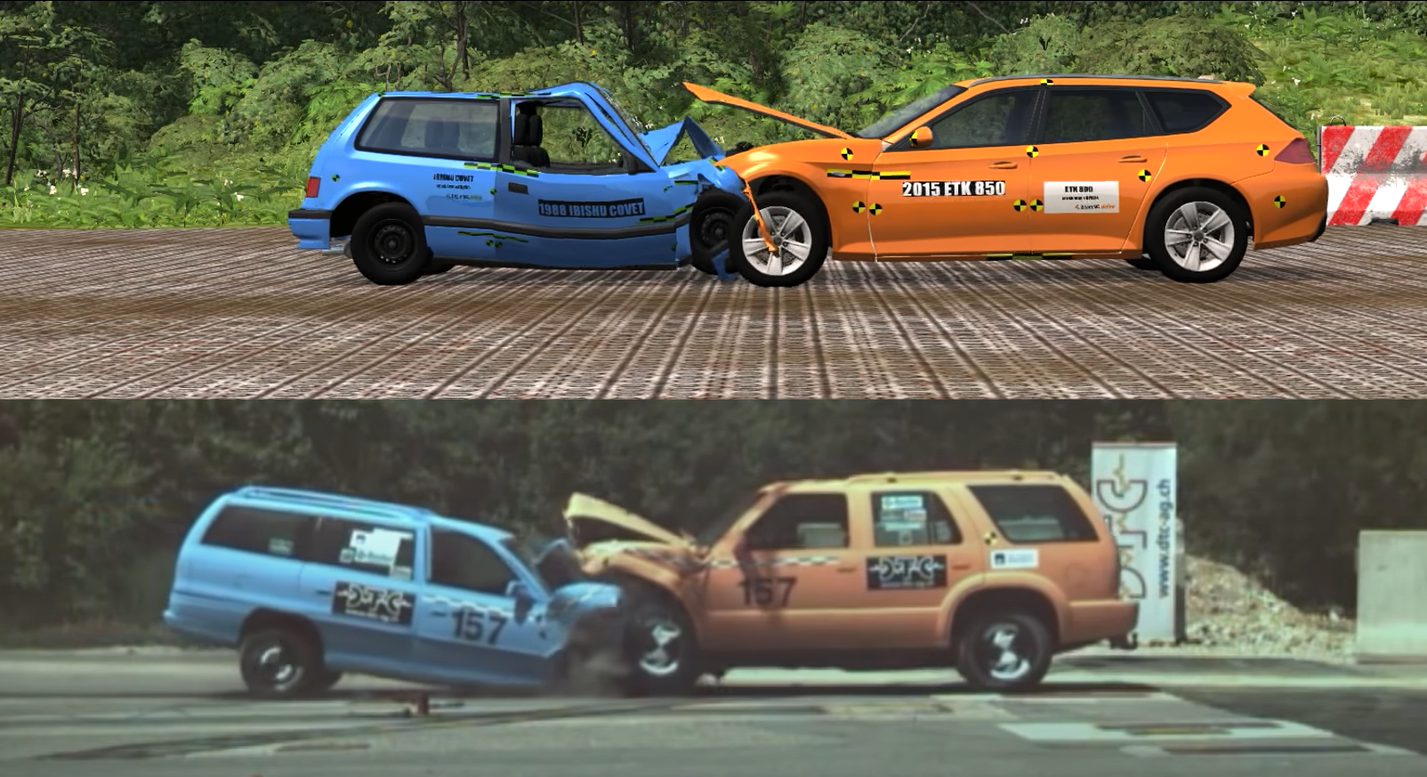
When and why synthetic data is used?

Slide 7


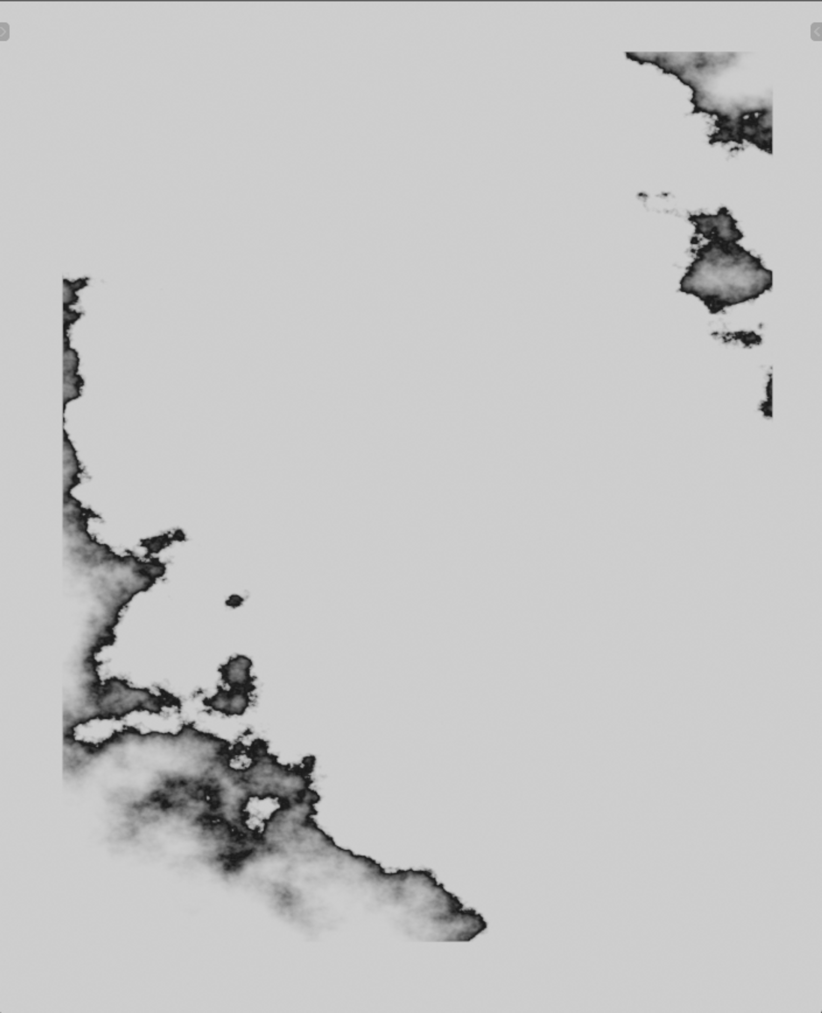

When and why
synthetic data is used?
Labeling like this
is so hard
Unlabeled image
Labeled Alpha
Labeled Interlayer

Slide 8

When and why
synthetic data is used?
Generated image
Original image
Generated Alpha / Automatically labeled
Generated Interlayer / Automatically labeled

Slide 9
When and why synthetic data is used?
Generated image
Original image
Generated Alpha / Automatically labeled
Generated Interlayer / Automatically labeled

Slide 10
When and why synthetic data is used?
Labeling like this
is so easy
Generated image
Original image
Generated Alpha / Automatically labeled
Generated Interlayer / Automatically labeled

Slide 11
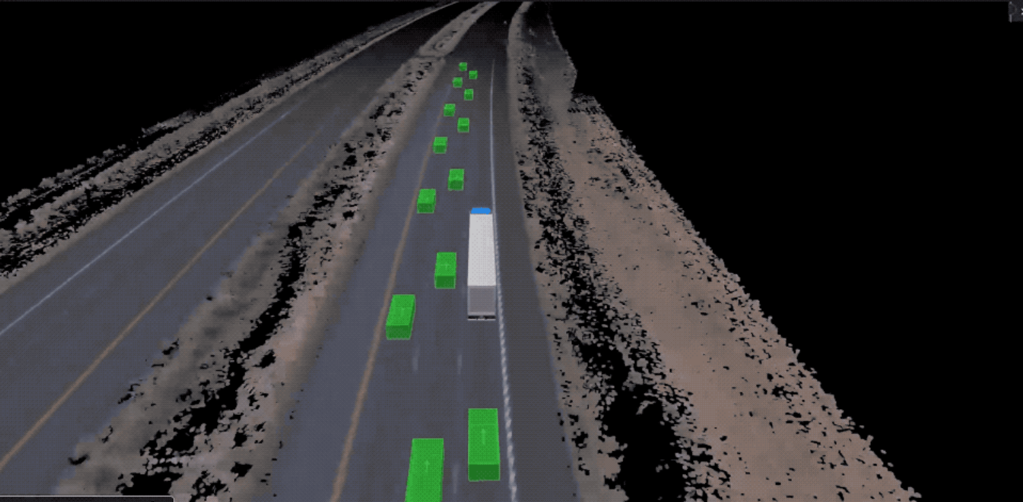
Cases of synthetic data application
Self-driving vehicles
by Waymo

Slide 12
Cases of synthetic data application
Virtual factory facility
by NVIDIA x BMW

Slide 13
Cases of synthetic data application
Fraud Prevention by American Express
The company used GANs to synthesize
fraudulent cases on which they did not
have enough data.

